Slide 1
Russian Internet Measurements Hackathons
isavnin@theopennet.ru

Slide 2
Why?
have fun
engage community
study our local Internet Infrastructure

Slide 3
Hackathons
First - 27-28 august 2016
Second - 11-12 February 2017
Third - 20-21 May 2017

Slide 4
Organizational
by volunteers
at community center (“Boiling Point” state-run coworking)
water coffee/tea and stroopwaffles
budget: first - 50 euro second - 30 euro (we became more professional!)

Slide 5
First hackathon results
30 registrations
2,5 projects survived:
“Critical Infrastructure of Russian Internet analysis based on European approach”
“Routing and data plane comparasion at the border of Russia”
“Russian Open Data and RIPE NCC”

Slide 6
Critical Infrastructure of Russian Internet analysis based on European approach
non-programming task

Slide 7
Резюме исследования (I)
CII Research
Moscow Hackathon
Oleg Demidov
28.08.2016
В международной практике нет единого подхода к регулированию КИИ и единое понимание того, как соотносятся с КИИ сервисы и инфраструктура Интернета.
Нет универсальной методологии, таксономии и системы критериев для категорирования и классификации КИИ
Классификация существующих подходов:
(Япония, США и проч.) Объект регулирования - ИТ-инфраструктура КВО, категорирования и таксономии является производной по отношению к КВО. Интернет и сервисы ИТ-отрасли, не выделяются в отдельный сектор КВО.
(РФ) КИИ = отдельная категория объектов регулирования, но по системе критериев и таксономии производна по отношению к КВО. В ряде случаев понятие КИИ привязывается к АСУ ПТП КВО. Интернет + другие сети передачи данных относятся к КИИ, но в привязке к функционированию КВО.
(ЕС, Германия, Швеция) ИТ+Интернет = отдельная сфера регулирования; вместо КИИ – жизненно важные услуги (ЖВУ) и критически важные услуги (КВУ).
‹#›

Slide 8
Эволюция постановки задачи
Мы измеряем количество трансграничных переходов
Мы измеряем количество физических каналов на трансграничных переходах
Мы сравниваем теоретические данные ОЗИ и эмпирические данные Атласа

Slide 9
Routing and data plane comparasion at the border of Russia
studying routing and data plane correlation on Russian "borders". At the moment of hackathon it was discovered that over 95% of traces vs bgp paths do not correlate.
as post-hackathon study shown modern IXP interference.

Slide 10
Second hackathon results
40 registrations
2,5 projects survived:
“IPv4 space in reserve in Russia” (¾ of /8)
“Distribution of announcements of IP space” (actually became “Geolocation Quality is poor”)
“Verifying Ripe Atlas probe geolocation by analysis of RTT to neighbour probes” (and discovered bug in Atlas API)

Slide 11
Distribution of announcements of IP space” (actually became “Geolocation Quality is poor”)
Based on RIPE Stat
some geolocations are funny
many prefixes registered inside country are announced outside
IPv6 geolocation is not geolocation at all

Slide 12
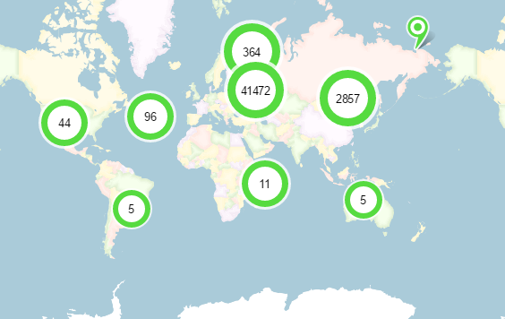
RU v4

Slide 13
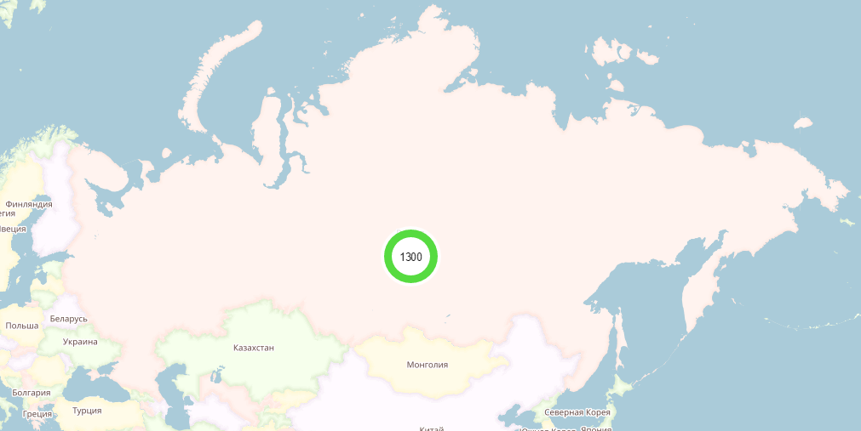
RU v6

Slide 14
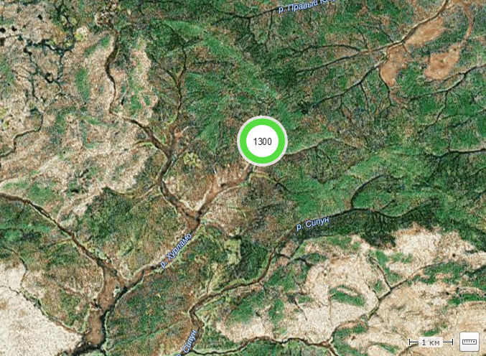
RU v6

Slide 15
Verifying Ripe Atlas probe geolocation by analysis of RTT to neighbour probes
https://github.com/darkk/atls-hktn :
Original goal: measure latency between geographically close points and pinpoint abnormally high latencies (bad peering?) compared to speed of light in fiber.
The goal was shifted to replace active measurements with historical measurements analytics, modified goal was to find latency outliers between two geocoded endpoints, especially violations of speed of light (showing geocoding incorrectness).

Slide 16
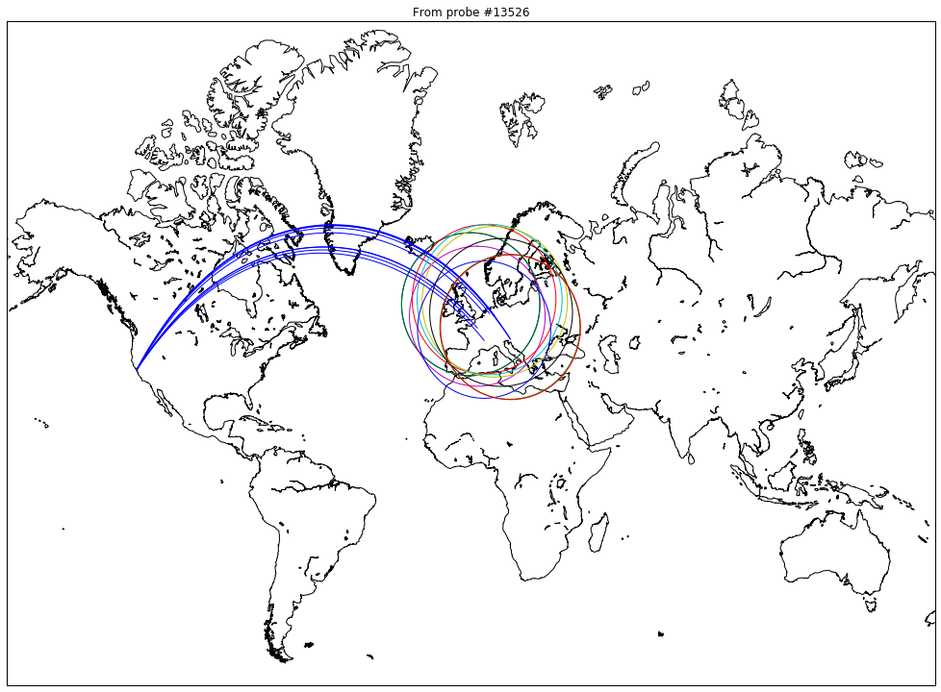

Slide 17
Outcome
there is a lot things to study and measure in Internet
not much people aware of Internet measurements data
community need to be engaged
and you need to communicate and promote MORE!!!

Slide 18
Third hackathon
20-21 May 2017 (weekend before ENOG13) by “the openNet” with “Ingria Business Park”
Deferred Success!

Slide 19
More Hackathons?
Everyone welcome!*
*including sponsors

